Slide 1

江苏致高远智能装备有限公司
CG Snap Assembly

Slide 2


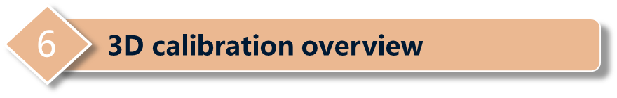


1
Customer request
2
Design concept
3
Machine overall
4
Machine layout introduce

Slide 3
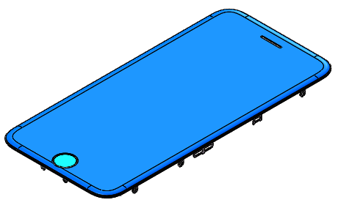
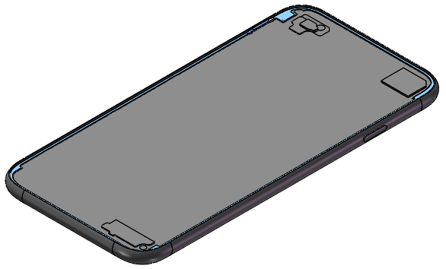
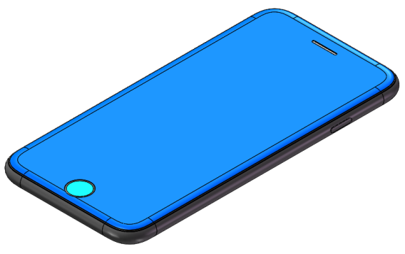
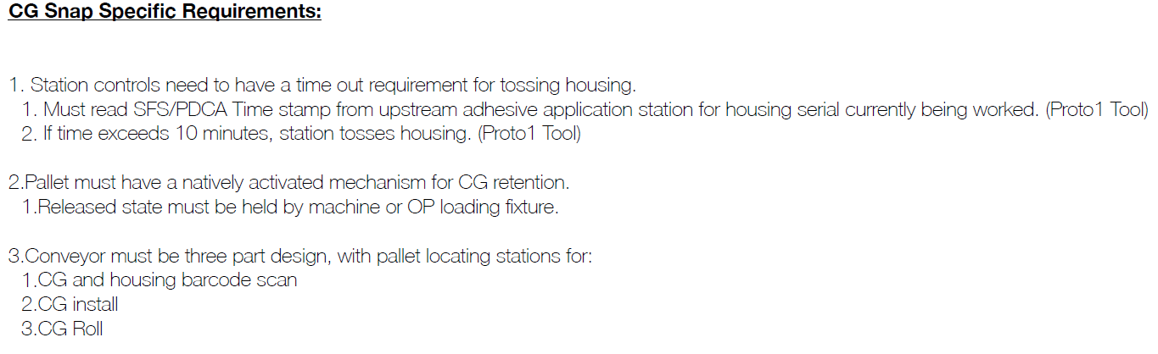
1
Customer Request
CG
Housing
Assembly

Slide 4
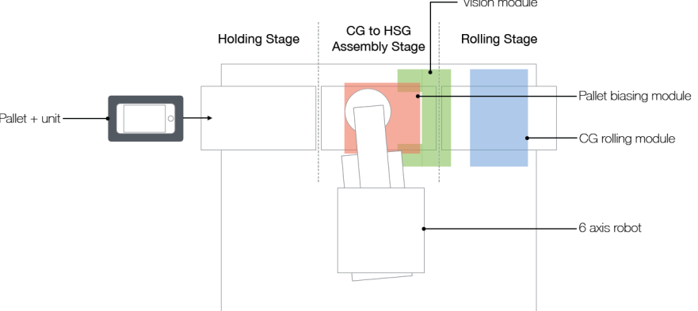
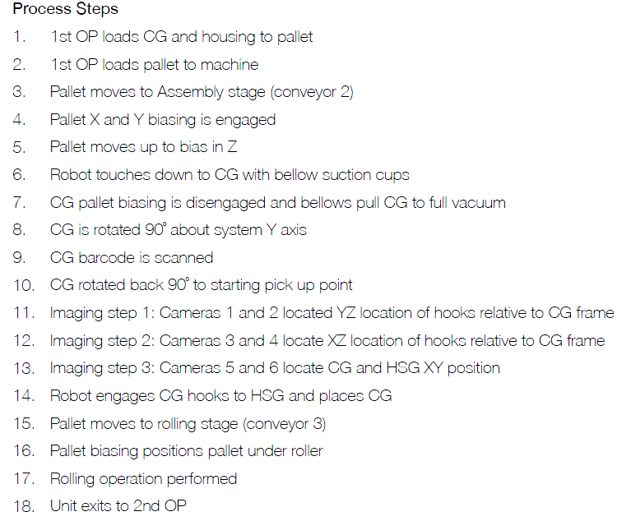
1
Customer Request
Layout

Slide 5
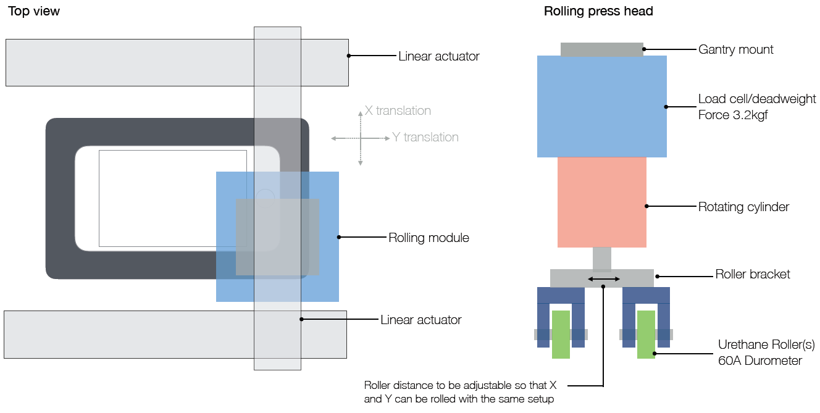
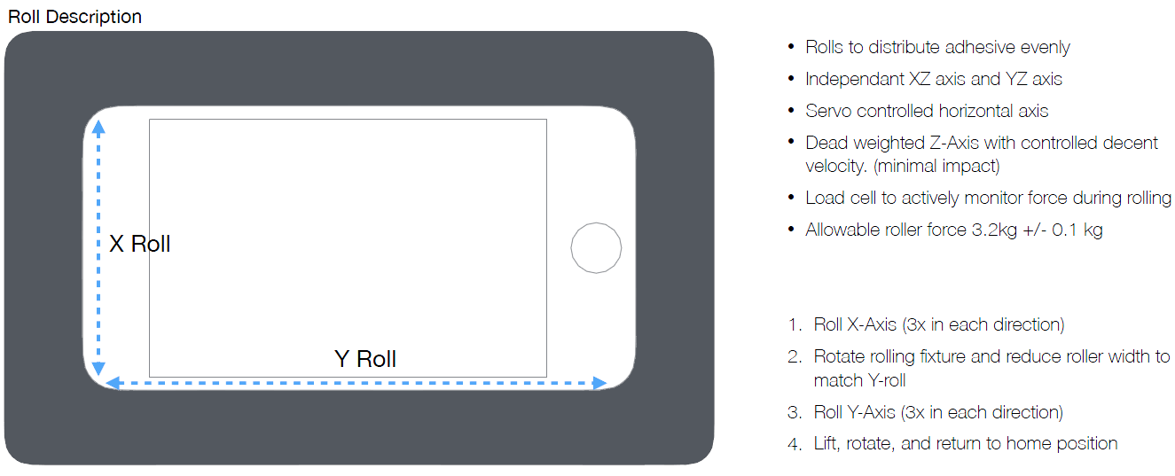
1
Customer Request
CG Press
Roller Pressing：

Slide 6
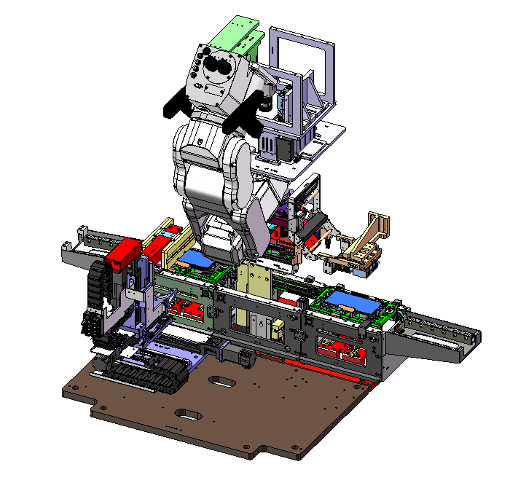
2
Design Concept
Process Summary
1. Load CG and HSG to pallet, then put pallet to equipment conveyor line.
2. Scan barcode and then assemble CG to HSG.
3. Rolling press CG.
4. Unload Pallet.

Slide 7
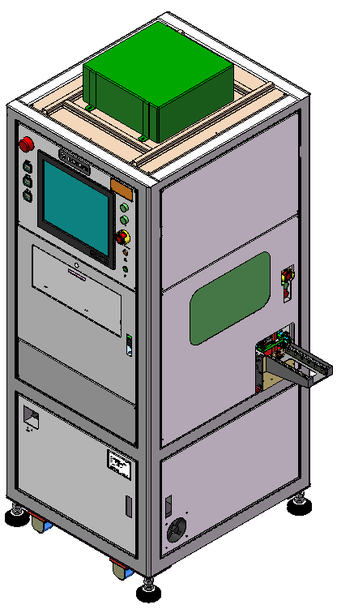
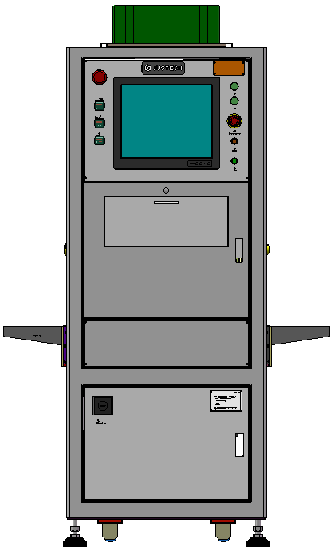
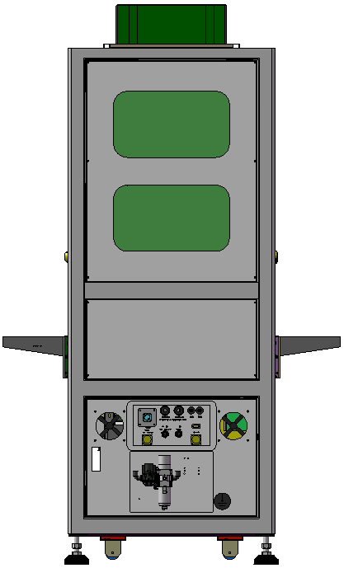
3
Machine Overview
Front View
Back View
FFU
Indication Light
Monitor
2000mm
Keyboard & Mouse
235mm
800mm
Power Switch
750mm
850mm

Slide 8
4
Machine Layout Introduction
6-Axis Robot
CCD1、2
CCD5
Pallet
CCD3、4
Pressing module
Conveyor module

Slide 9
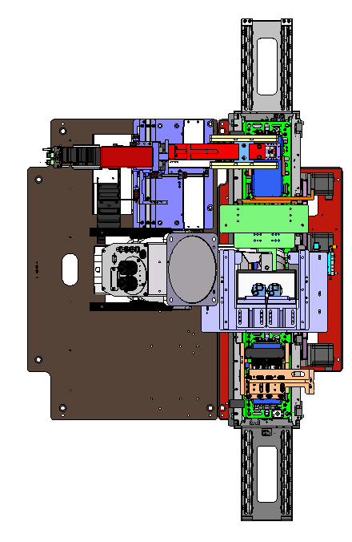
4
Machine Layout Introduction
Unloading
Conveyor
Robot
Pressing
FATP line
CCD
Loading

Slide 10

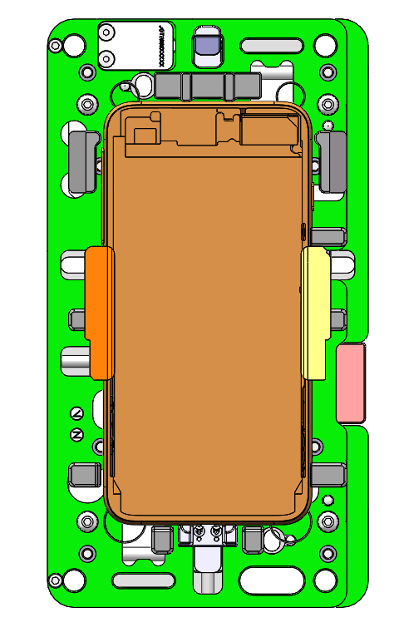
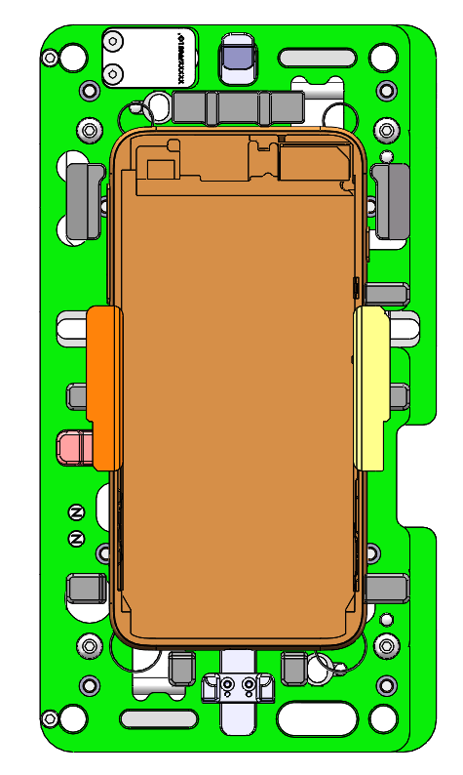
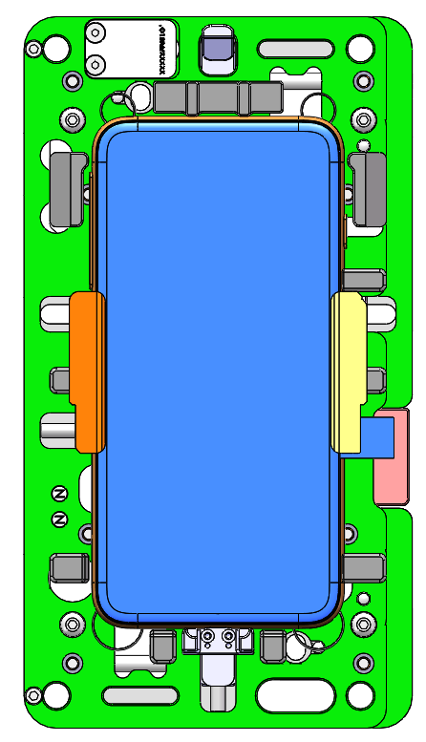
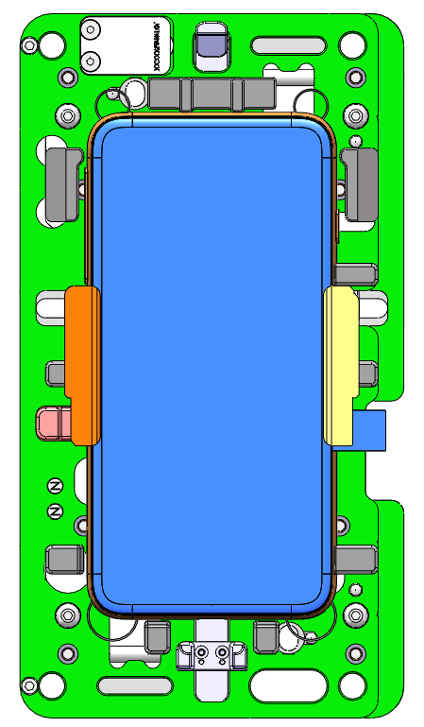
JOT Pallet
Y
220mm
Y
120mm
HSG Clamp
HSG Release
HSG+CG Clamp
HSG+CG Release

Slide 11

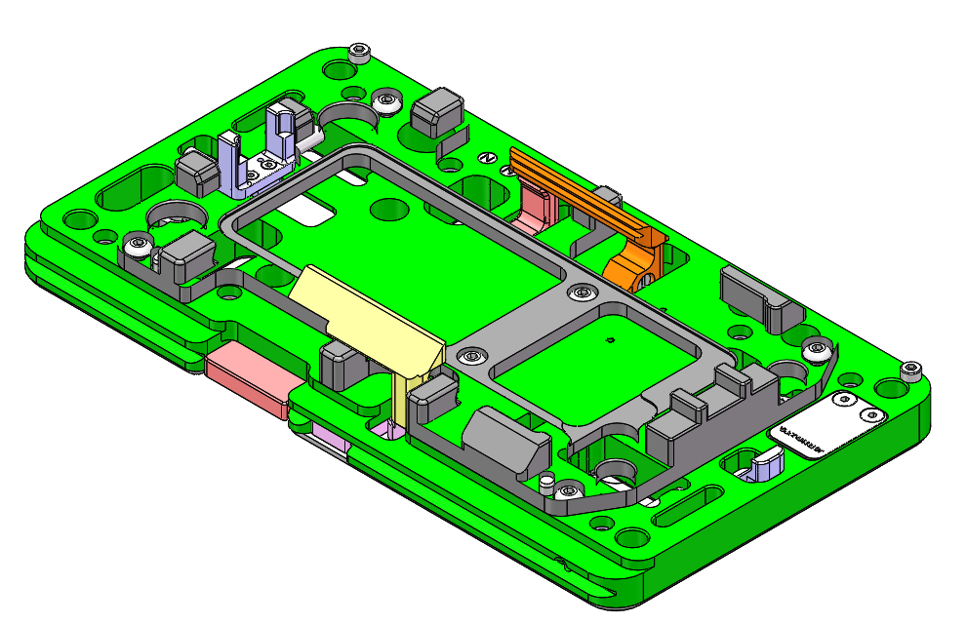
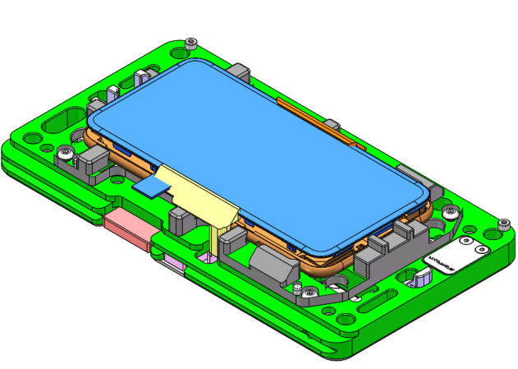
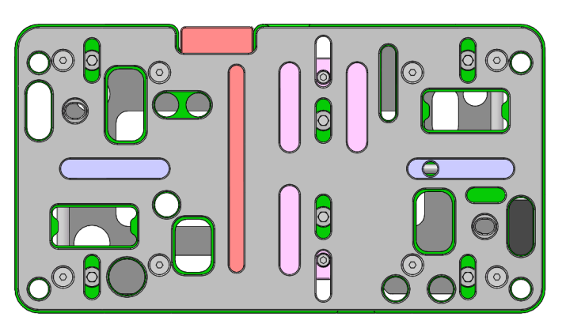
JOT Pallet
HSG Clamping block
CG Supports 1
B
HSG datum block
Hand push direction
Pallet Clamp Location 1
Pallet Clamp Location 2
A
Hand push direction
1、When push block B, release clamp of CG, put CG into pallet;
2、When push block A, release clamps of HSG and CG, then take HSG+CG out of pallet.

Slide 12
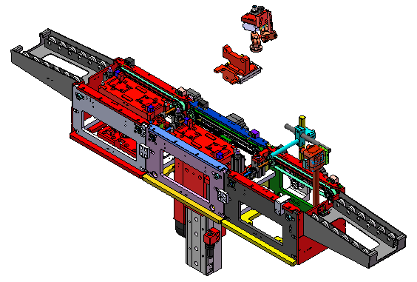
Conveyor
Conveyor 2
(Tunnel lift option)
Conveyor 1
Conveyor 3
Unloading
Pallet Scanning
Loading
HSG Scanning

Slide 13
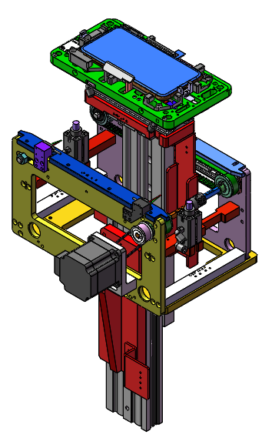
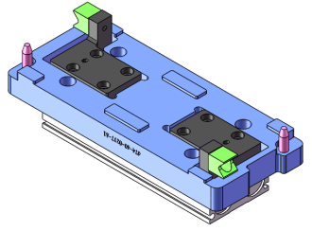
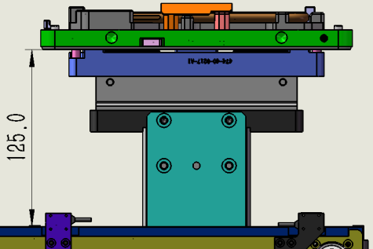
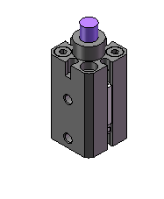
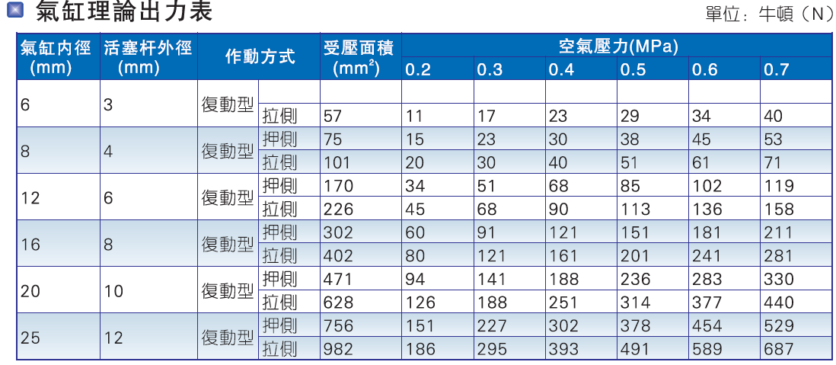
Conveyor-2
Pallet positioning and clamping
Blocking cylinder
Lifting height 125mm

Slide 14
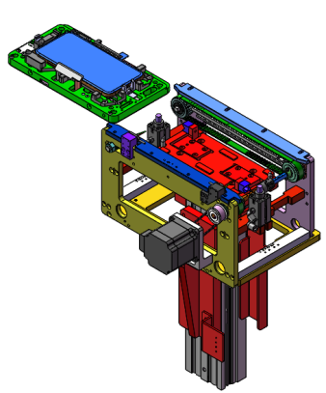
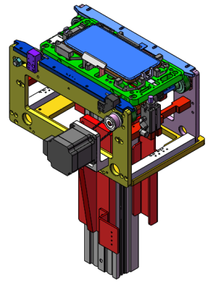
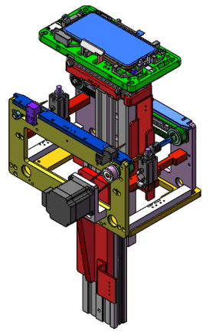
Conveyor-2
Pallet arrive at conveyor-2
Pallet climbing
Pallet assembly location
Carry module move back
Pallet move down
Pallet release

Slide 15

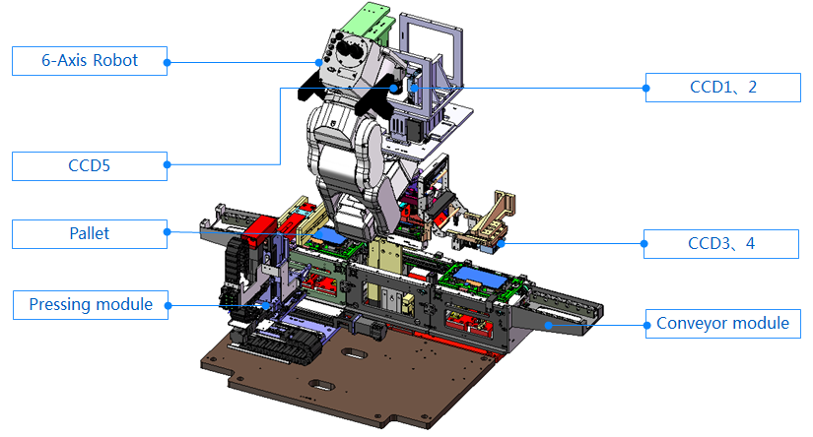
Conveyor Conversion
The left feeding direction and the layout of each module as shown, if need change to right feeding direction, following changes have to be done:
1. Interchange the location of clamping blocks between conveyor 1 and 3.
2. The installation position of the robot needs to be moved from left top to right top.
3. The position of CG pressing module should be moved as well.
In summary:
Feeding direction was changed, conveyor 2 without any changes but other modules are required to be changed

Slide 16
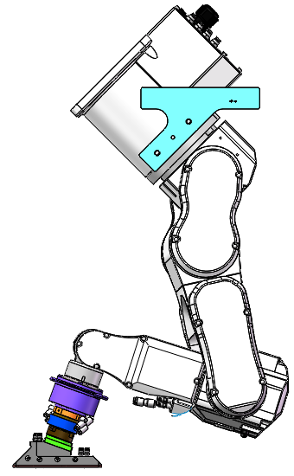
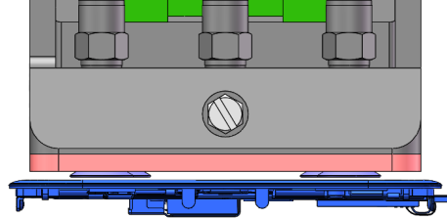
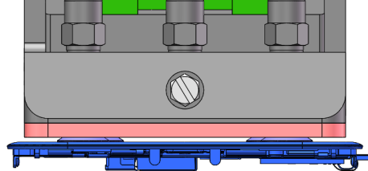
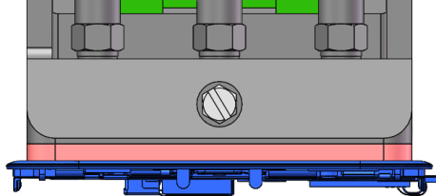
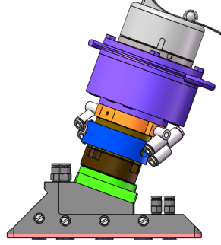
6-axis Robot
C4-A601S/
RC700
Robot suck CG process
1st joint
Step1: Vacuum nozzle move to CG above
2nd joint
3rd joint
5th joint
Step2：Vacuum nozzle touch CG
1.5mm
6th joint
4th joint
Epson Force Sensor S250-N
Step3：Vacuum nozzle suck CG
Quick-change Connector

Slide 17
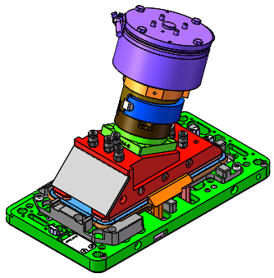
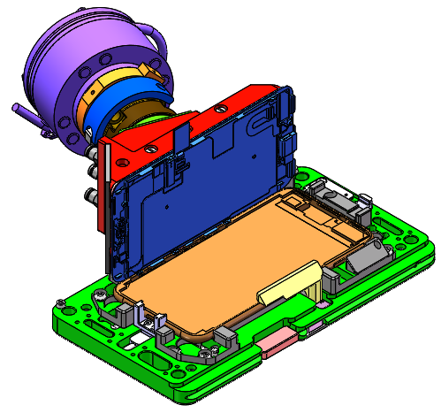
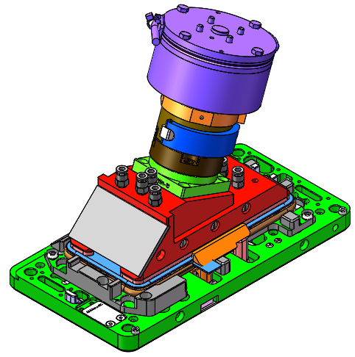
Robot assembly Steps
Step1: Robot move down to suck up CG with suction cups
Step2: CG is rotated 90° for CG and HSG barcode scanning
Step3: CG is rotated back 90° to pick up point

Slide 18
Robot assembly Steps
Step4: Cameras inspect YZ & XZ location of CG
Step5:Robot engages CG hooks to HSG then places CG

Slide 19
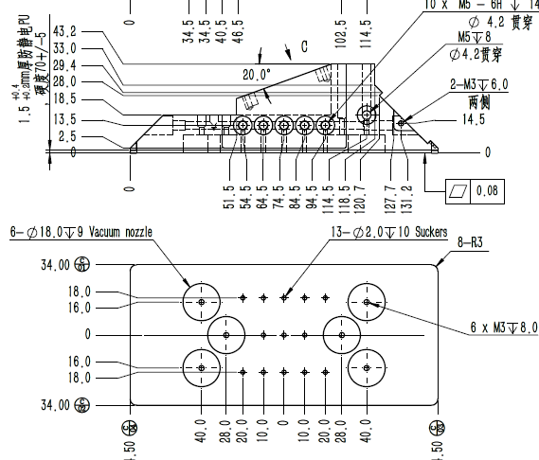
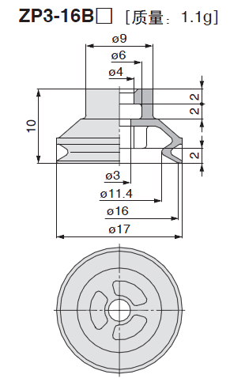
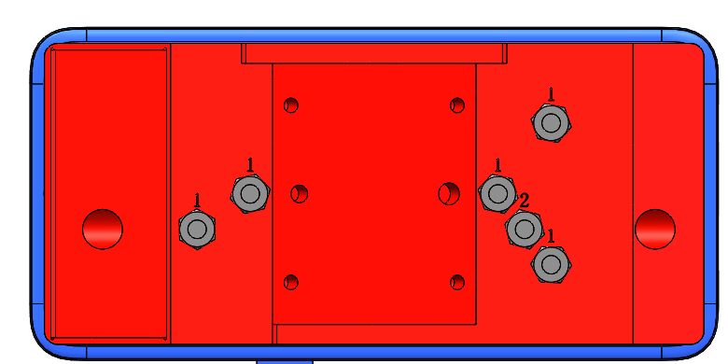
End effector Suction Plate
Vacuum cup
3.2mm
Vacuum Cup Material：Silicone
Brand：SMC
Model：ZP3-16BS
Hardness：45°
Suction Diameter：Φ16.0mm
3.2mm

Slide 20
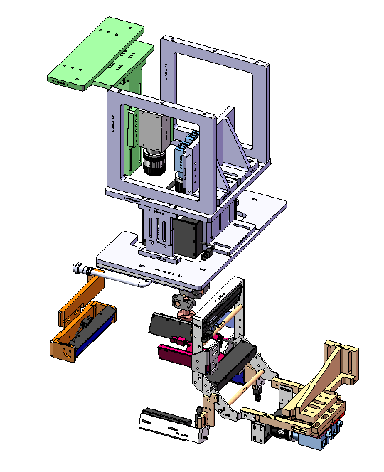
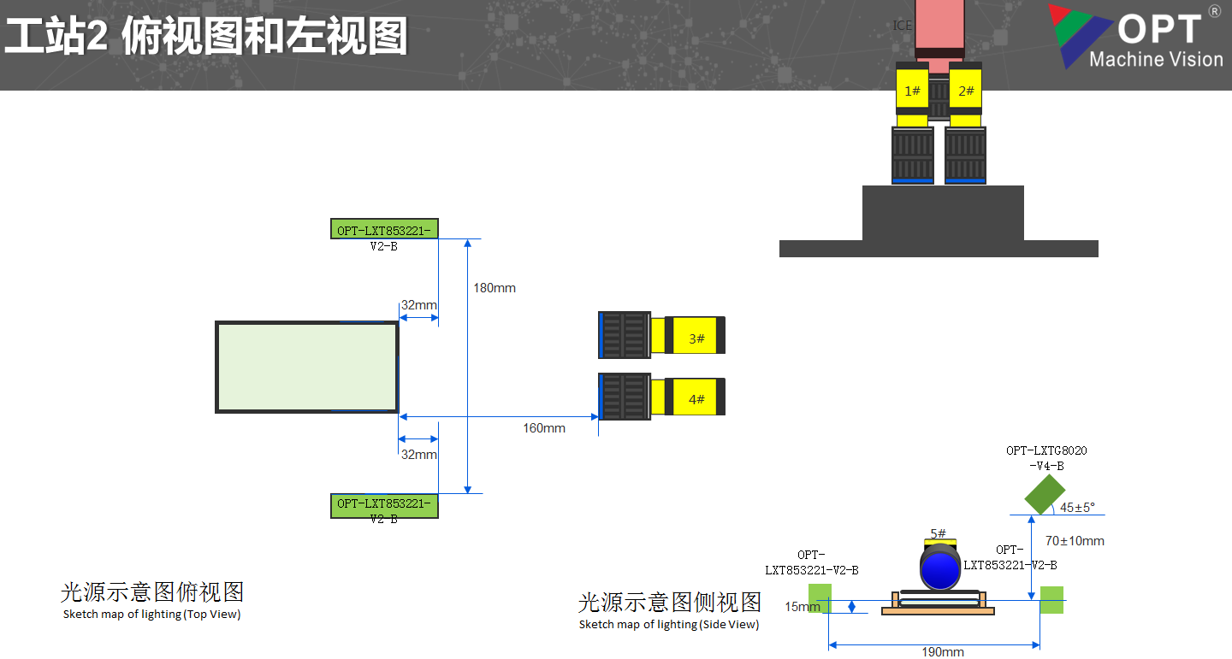
CCD
ICE Camera
CCD1、2
CCD3、4

Slide 21
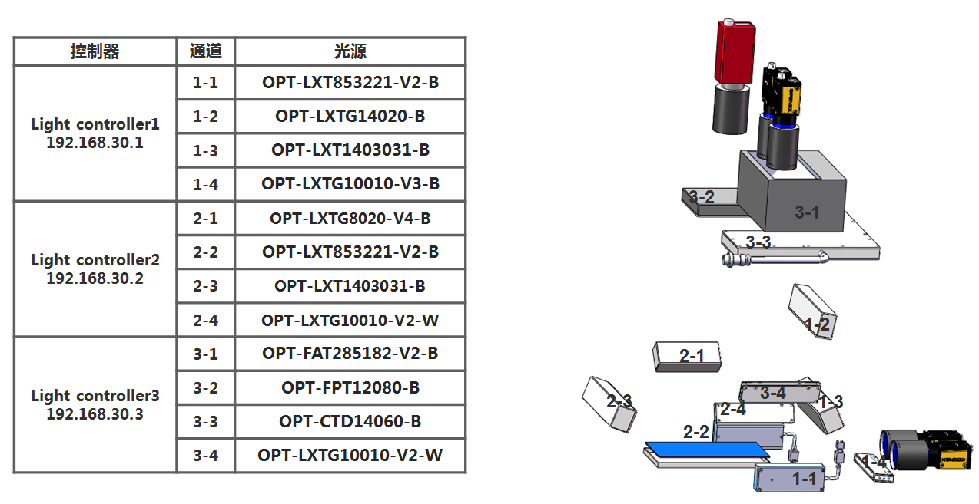
CCD

Slide 22
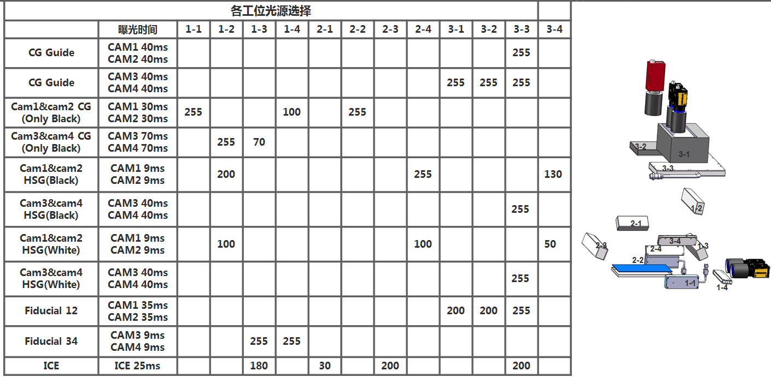
Vision Proposal

Slide 23
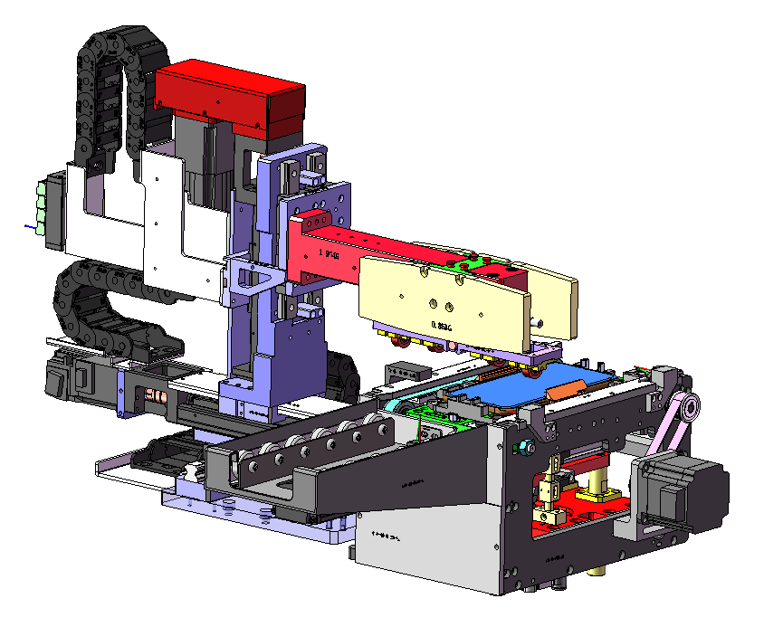
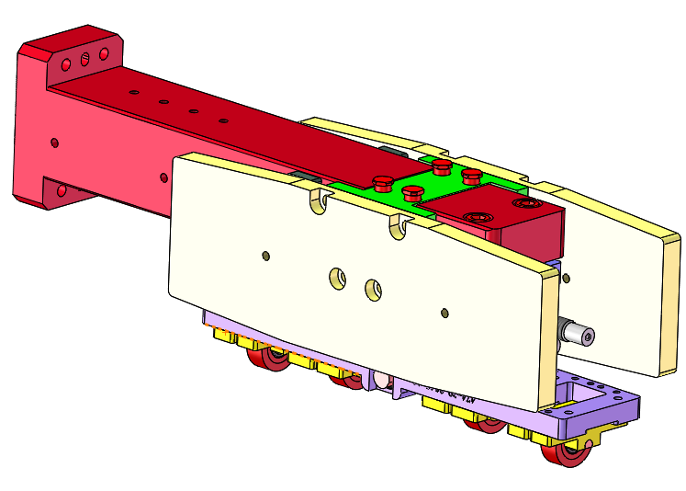
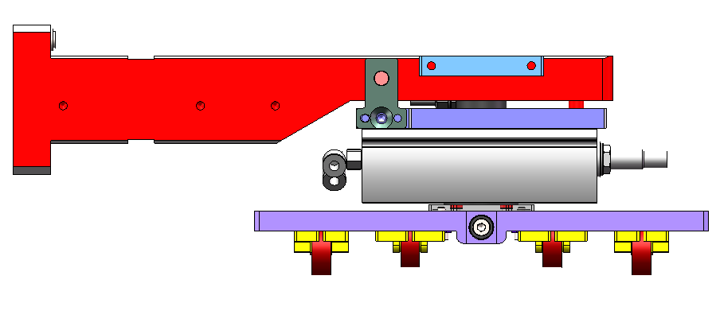
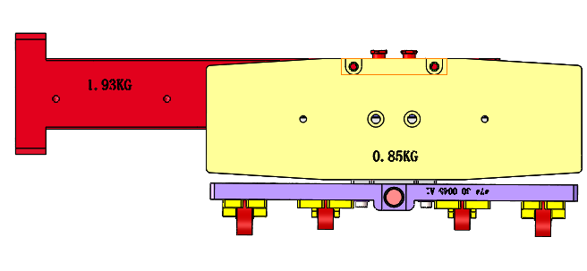

CG Pressing
Actual force:
Weight:3.5kg
Weight:1.7kg
Total Weight:5.2kg

Slide 24



CG Pressing
D20: Path Option 1, from unit middle to middle. 4cycles
D21: Path Option 2, from unit edge to edge. 3cycles
D22: Path Option 1, from unit middle to middle. 3cycles
Customer defined roller spec and rolling position:
Rolling cycles start completed cycles on the length and width of CG surface

Slide 25







D21 CG Pressing
Roller Diameter 20mm
3.6mm
New Pallet
1.4mm
155.6mm
Roller force：5.2Kgf, 3 cycles
Roller Material: TPU,
Hardness: 60 Shore A;
Roller diameter: 20mm;
TPU thickness:2.5mm
Width: 7.6mm.
3.6mm
75.3mm
1.4mm
Trolley external diameter: Φ20mm
1. Rolling CG long edge, turning rolls higher than pallet CG claw: 3.6mm;
2. Rolling CG short edge, turning rolls higher than pallet HSG rib: 3.6mm;

Slide 26





D20 CG Pressing
Roller Diameter 20mm
3.4mm
1.3mm
New Pallet
135.9mm
Roller force：5.0Kgf, 4cycles
Roller Material: TPU,
Hardness: 60 Shore A;
Roller diameter: 20mm;
TPU thickness:2.5mm
Width: 7.6mm.
3.4mm
1.3mm
64.68mm
Trolley external diameter: Φ20mm
1. Rolling CG long edge, turning rolls higher than pallet CG claw: 3.4mm;
2. Rolling CG short edge, turning rolls higher than pallet HSG rib: 3.4mm;

Slide 27







D22 CG Pressing
Roller Diameter 28mm
7.6mm
1.2mm
New Pallet
141.1mm
Roller force：5.2Kgf, 3 cycles
Roller Material: TPU,
Hardness: 60 Shore A;
Roller diameter: 28mm;
TPU thickness:2.5mm
Width: 7.6mm.
8.2mm
1.2mm
68.5mm
Trolley external diameter: Φ28mm
1. Rolling CG long edge, turning rolls higher than pallet CG claw: 7.6mm;
2. Rolling CG short edge, turning rolls higher than pallet HSG rib: 8.2mm;

Slide 28







Pressure analysis
MR
G
MR
F
Balancing weight fixture
Pressure sensor
X
Balancing weight floating
MR
G
sliding
bracket
MR
Pressure sensor
Balancing weight
When rolling towards to the direction X, the sliding will generate static torque MR from the bracket.
When the balancing weight and the bracket are fixed relatively, the torque MR received by the bracket will generate a yawing force F towards the sensor. So during the rolling, the contemporary force tested by the sensor are the gravity G and yawing force F of balancing weight. And the pressure data fluctuate a lot.
After the test, when the balancing weight floating is assembled, the balancing weight can flow upwards and downwards, which will neutralize the static torque generated on bracket by the sliding. Then the less influence of torque fluctuation received from the sensor, the more stable the values of the pressure sensor will be.

Slide 29


After being Congex provide latest plan update
D21:36x60mm
D20:36x58mm

Slide 30


Slide 31




Slide 32




D21
D22
D20
Roller force：5.2Kgf,
3 cycles
Roller Material: TPU,
Hardness: 60 Shore A;
Roller diameter: 20mm;
TPU thickness:2.5mm
Width: 7.6mm.
Roller force：5.2Kgf,
3cycles
Roller Material: TPU,
Hardness: 60 Shore A;
Roller diameter: 28mm;
TPU thickness:2.5mm
Width: 7.6mm.
Roller force：5.0Kgf,
4 cycles
Roller Material: TPU,
Hardness: 60 Shore A;
Roller diameter: 20mm;
TPU thickness:2.5mm
Width: 7.6mm.
When the machines switch, that needs to change the rollers into the ones with correspondent diameters.
Robot suction plate: the suction plate needs to be replaced due to the production sizes are different.

Slide 33

外观检测介绍 Describe of station

Slide 34

深度学习介绍 Introduction to deep learning
: 数据增强：确保模型稳定
减少误判
联合推断：多视角、多图片联合推断，减少过杀漏检率
迁移训练库：是基于历史数据的经验，对未来数据的推断
标签体系：实物与图像结合确保训练、标注的准确性；
深度学习
DEEP LEARNING
S-GAAMA
提高效率
提升良率
•像素级缺陷分割；
•高分辨率的网格结构提升小缺陷检测性能；
•多种在线工具进行数据增强，确保模型稳定；
•置信度和工艺辅助相结合的分类判断；
•调用模型迁移训练库，大数据识别缺陷；
•依据光度立体多视角联合缺陷判断体系；
•实物与图像结合的标签体系，确保训练、标注的准确性；
•线性、灰度多维度关联因子去除干扰，减少过杀、漏检；
多维度关联：线性、灰度等关联因子去除干扰，减少过杀、漏检
效率：算法时间短
检测图片放入算法中，对图片进行像素分割，选用高分辨率的网格结构，进行数据增强处理，按照缺陷类型不同赋予不同标签，结合多个视觉图像以及工艺参数联合判断，根据置信度分数调用迁移模型库数据，能够增强和快速的输出判定结果。

Slide 35
相机镜头详情
相机核心参数
检测面 |  | 侧面 | 正面
型号 |  | MVCA-500W-UC-24.2-07
相机 | 品牌 | monoview
 | 传感器类型 | CMOS，全局快门
 | 传感器型号 | IMX250
 | 像元尺寸 | 3.45 µm × 3.45 µm
 | 靶面尺寸 | 2/3”
 | 分辨率 | 2448 × 2048
镜头 | 型号 | MVCL-WL-0.4X196-3/2-N-C-0 | MVCL-WL-0.4X196-3/2-N-C-0
 | 品牌 | SAM | SAM
 | 镜头类型 | 定焦 | 远心
 | 放大倍率 | 0.3 | 0.2
 | 工作距离 | 197 | 228mm
 | 景深 | 5.3mm | 12.1mm
 | 视野 | 21mm*17mm | 21mm*17mm
激光核心参数
检测面 |  | 底面
型号 |  | MVLA-L-0860-07
 | 品牌 | monoview
 | 工作距离 | 60
 | Z向重复性 | 0.2um
 | X向重复性 | 5um
 | X线宽 | 30
 | X向数据间距 | 12um
 | X向轮廓点数 | 3200

Slide 36
设施要求/布局 Facility Requirements / Layout
车间设施要求 Facility requirements needed on the shop-floor
    频率 Frequency: 50/60HZ;
    电压 Volt: 220V
    电流 Current: 10A
    功率 Total Power: 2.2KW/set
    气压 Pneumatic: 0.6-0.8MPa（气压稳定）
    重量（ｘｘｘ）
    气源要求 经过干燥处理，无油水
    环境温度 Ambient Temperature:18゜C -25゜C
    车间连接/IT要求：需要网口，数量：1pcs 上传流畅
    Shop Floor Connectivity / IT requirements: Need Netpoint,QTY:1pcs and upload shop flow

Slide 37




设备进气过滤装置
1、三联过滤装置
2、储气罐
3、三联过滤装置
4、真空过滤器
气源不纯故需要添加过滤装置其流程如下：
1、气源在进入设备前端优先过三联过滤装置；
2、经过三联件后进入储气罐；
3、储气罐出气口增加高精密过滤气源三联件；
4、最终在电磁阀后端再次增加一组过滤滤芯；

Slide 38
总结 Summary
项目可行性 Feasibility | YES
设备开发周期 L/T | 65个工作日
硬件主要配置 Configuration | 工控机-深度学习*2：I9 CPU，32G内存，专业图形显卡，2T硬盘+1T固态硬盘，21”液晶显示器
 | CCD 6 个 1000万高清定焦/远心镜头共 3个，线激光1套，光源若干
 | 高精度运动模组、运动伺服、马达等
软件主要配置 | 检测软件： SMV光测软件 / S-sigma 深度学习平台
每小时产能 PCS/H | CT=30s（稼动率＞95%,）
检测精度 Accuracy | 漏检≤0.5%、过杀≤7%
操作人员 Operator | 1人
备注 Remarks

Slide 39
THANK YOU FOR WATCHING
Jiangsu ZGY intelligent equipment Co.,Ltd
Tel:86-512-57565989
Fax:+86-512-57260163
E-mail: sales@jszgy.com
WEB:www.jszgy.com
No.6, kingdee road, kunshan city, jiangsu province

